Slide 1
Optimizing Regular Expression Matching with SR-NFA on Multi-Core Systems
Authors : Yang, Y.E. , Prasanna, V.K.
Publisher : Parallel Architectures and Compilation Techniques (PACT), 2011 International Conference on
Presenter : 楊皓中
Date : 2014/09/17
Department of Computer Science and Information Engineering
National Cheng Kung University, Taiwan R.O.C.
Notes:
1

Slide 2
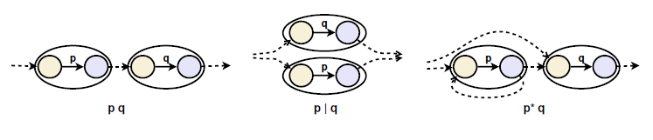
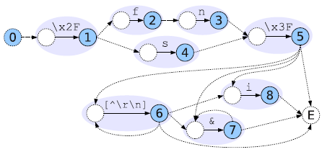
NFA(Basic modified McNaughton-Yamada Constructions)
\x2F(fn|s)\x3F[^\r\n]*(i|&*)

Slide 3
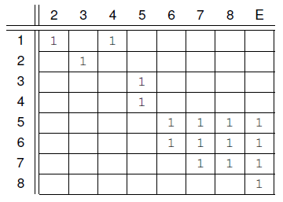
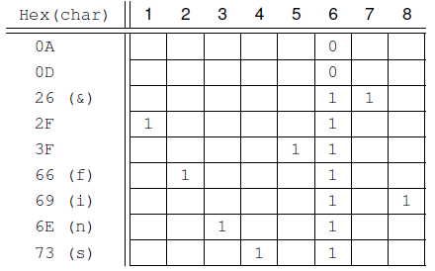
Single-Segment SR-NFA
State-reachability matrix
\x2F(fn|s)\x3F[^\r\n]*(i|&*)
Character-acceptance matrix
Input : \x2Ffn\x3Fssi
Q = 10000000 (initial state from root)
V = 00000000

Slide 4
SR-NFA ARCHITECTURE
State-reachability matrix
Character-acceptance matrix
Input : \x2Ffn\x3Fssi
T = Q = 10000000
V = T and C(\x2F)
= 10000000 and 10000100
= 10000000

Slide 5
SR-NFA ARCHITECTURE
State-reachability matrix
Character-acceptance matrix
Input : \x2Ffn\x3Fssi
T = R(V) or Q = R(1) or Q
= 01010000 or 10000000
=11010000
V : T and C(f)
= 11010000 and 01000100
= 01000000

Slide 6
SR-NFA ARCHITECTURE
State-reachability matrix
Character-acceptance matrix
Input : \x2Ffn\x3Fssi
T = R(V) or Q = R(2) or Q
= 00100000 or 10000000
= 10100000
V : T and C(n)
= 10100000 and 00100100
= 00100000

Slide 7
SR-NFA ARCHITECTURE
State-reachability matrix
Character-acceptance matrix
Input : \x2Ffn\x3Fssi
T = R(V) or Q = R(3) or Q
= 00001000 or 10000000
= 10001000
V : T and C(\x3f)
= 10001000 and 00001100
= 00001000

Slide 8
SR-NFA ARCHITECTURE
State-reachability matrix
Character-acceptance matrix
Input : \x2Ffn\x3Fssi
T = R(V) or Q = R(5) or Q
= 00000111 or 10000000
= 10000111
V : T and C(s)
= 10000111 and 00010100
= 00000100

Slide 9
SR-NFA ARCHITECTURE
State-reachability matrix
Character-acceptance matrix
Input : \x2Ffn\x3Fssi
T = R(V) or Q = R(6) or Q
= 00000111 or 10000000
= 10000111
V : T and C(s)
= 10000111 and 00010100
= 00000100

Slide 10
SR-NFA ARCHITECTURE
State-reachability matrix
Character-acceptance matrix
Input : \x2Ffn\x3Fssi
T = R(V) or Q = R(6) or Q
= 00000111 or 10000000
= 10000111
V : T and C(i)
= 10000111 and 00000101
= 00000101

Slide 11

Single-Segment SR-NFA
1.
memory complexity of the SRM grows quadratically in the number of states
$$n^{2}$$

Slide 12
Single-Segment SR-NFA
2.
bit-AND and bit-OR on the state vector becomes a proportionally more complex operation

Slide 13
Single-Segment SR-NFA
3.
the SRM is usually very sparse in the NFAs for most real-life regexes

Slide 14
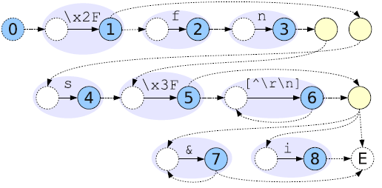
Multi-Segment SR-NFA
\x2F(fn|s)\x3F[^\r\n]*(i|&*)

Slide 15
Multi-Segment SR-NFA
Forward-pseudo state
Segment 0
Segment 1
Segment 2
Notes:
which relay forward -transitions to the next segment

Slide 16
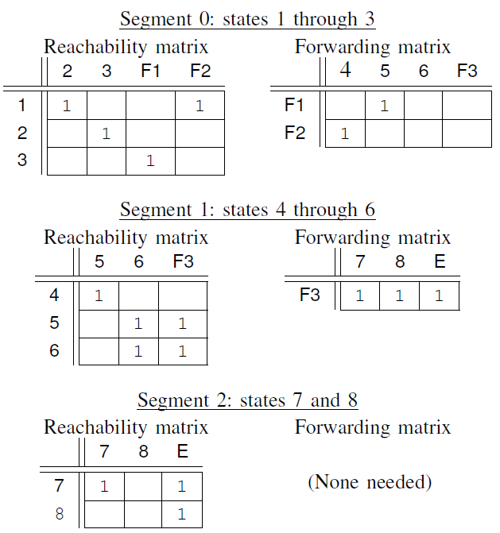
Multi-Segment SR-NFA
F1
F2
F3

Slide 17
Multi-Segment SR-NFA
F1
F2
F3
Input : \x2Ffn\x3Fssi
Segment 0 : (1,2,3)
Q : 100
V : 000
Segment 1 : (4,5,6)
Q : 000
V : 000
Segment 2 : (7,8)
Q : 000
V : 000

Slide 18
Multi-Segment SR-NFA
F1
F2
F3
Input : \x2Ffn\x3Fssi
Segment 0 : (1,2,3)
T = Q = 100
V = T and C(\x2F)
= 100 and 100
= 100
Segment 1 : (4,5,6)
T = Q = 000
V = T and C(\x2F)
= 000 and 001
= 000
Segment 2 : (7,8)
T = Q = 000
V = T and C(\x2F)
= 000 and 000
= 000

Slide 19
Multi-Segment SR-NFA
F1
F2
F3
Input : \x2Ffn\x3Fssi
Segment 0 : (1,2,3)
T = 100
V = 100
Segment 1 : (4,5,6)
T = 000
V = 000
Segment 2 : (7,8)
T = 000
V = 000
F1=0,F2=0
F3 = 0
non

Slide 20
Multi-Segment SR-NFA
F1
F2
F3
Input : \x2Ffn\x3Fssi
Segment 0 : (1,2,3)
T = R(V)orQ = 010 or 100
= 110
V =
Segment 1 : (4,5,6)
T = 000
V =
Segment 2 : (7,8)
T = 000
V =
F1=0,F2=1
F3 = 0
non

Slide 21
Multi-Segment SR-NFA
F1
F2
F3
Input : \x2Ffn\x3Fssi
Segment 0 : (1,2,3)
T = R(V)orQ = 010or100
= 110
V =
Segment 1 : (4,5,6)
T = 100
V =
Segment 2 : (7,8)
T = 000
V =
F1=0,F2=1
F3 = 0
non

Slide 22
Multi-Segment SR-NFA
F1
F2
F3
Input : \x2Ffn\x3Fssi
Segment 0 : (1,2,3)
T = R(V)orQ = 010or100
= 110
V = 110 and 010 = 010
Segment 1 : (4,5,6)
T = 100
V = 100 and 001 = 000
Segment 2 : (7,8)
T = 000
V = 000
F1=0,F2=0
F3 = 0
non

Slide 23
Multi-Segment SR-NFA
F1
F2
F3
Input : \x2Ffn\x3Fssi
Segment 0 : (1,2,3)
T = R(V)orQ = 001or100
= 101
V =
Segment 1 : (4,5,6)
T = 000
V =
Segment 2 : (7,8)
T = 000
V =
F1=0,F2=0
F3 = 0
non

Slide 24
Multi-Segment SR-NFA
F1
F2
F3
Input : \x2Ffn\x3Fssi
Segment 0 : (1,2,3)
T = R(V)orQ = 001or100
= 101
V = 101 and 001 = 001
Segment 1 : (4,5,6)
T = 000
V = 000
Segment 2 : (7,8)
T = 000
V = 000
F1=0,F2=0
F3 = 0
non

Slide 25
Multi-Segment SR-NFA
F1
F2
F3
Input : \x2Ffn\x3Fssi
Segment 0 : (1,2,3)
T = R(V)orQ = 000or100
= 100
V =
Segment 1 : (4,5,6)
T = 000
V =
Segment 2 : (7,8)
T = 000
V =
F1=1,F2=0
F3 = 0
non

Slide 26
Multi-Segment SR-NFA
F1
F2
F3
Input : \x2Ffn\x3Fssi
Segment 0 : (1,2,3)
T = R(V)orQ = 000or100
= 100
V =
Segment 1 : (4,5,6)
T = 010
V =
Segment 2 : (7,8)
T = 000
V =
F1=1,F2=0
F3 = 0
non

Slide 27
Multi-Segment SR-NFA
F1
F2
F3
Input : \x2Ffn\x3Fssi
Segment 0 : (1,2,3)
T = R(V)orQ = 000or100
= 100
V = 100 and 000 =000
Segment 1 : (4,5,6)
T = 010
V = 010 and 011 = 010
Segment 2 : (7,8)
T = 000
V = 000
F1=0,F2=0
F3 = 0
non

Slide 28
Multi-Segment SR-NFA
F1
F2
F3
Input : \x2Ffn\x3Fssi
Segment 0 : (1,2,3)
T = R(V)orQ = 000or100
= 100
V =
Segment 1 : (4,5,6)
T = 001
V =
Segment 2 : (7,8)
T = 000
V =
F1=0,F2=0
F3 = 1
non

Slide 29
Multi-Segment SR-NFA
F1
F2
F3
Input : \x2Ffn\x3Fssi
Segment 0 : (1,2,3)
T = R(V)orQ = 000or100
= 100
V =
Segment 1 : (4,5,6)
T = 001
V =
Segment 2 : (7,8)
T = 111
V =
F1=0,F2=0
F3 = 1
non

Slide 30
Multi-Segment SR-NFA
F1
F2
F3
Input : \x2Ffn\x3Fssi
Segment 0 : (1,2,3)
T = R(V)orQ = 000or100
= 100
V = 100 and 000 = 000
Segment 1 : (4,5,6)
T = 001
V = 001 and 101 = 001
Segment 2 : (7,8)
T = 111
V = 111 and 000 = 000
F1=0,F2=0
F3 = 0
non

Slide 31
Multi-Segment SR-NFA
F1
F2
F3
Input : \x2Ffn\x3Fssi
Segment 0 : (1,2,3)
T = R(V)orQ = 000or100
= 100
V =
Segment 1 : (4,5,6)
T = 001
V =
Segment 2 : (7,8)
T = 000
V =
F1=0,F2=0
F3 = 1
non

Slide 32
Multi-Segment SR-NFA
F1
F2
F3
Input : \x2Ffn\x3Fssi
Segment 0 : (1,2,3)
T = R(V)orQ = 000or100
= 100
V =
Segment 1 : (4,5,6)
T = 001
V =
Segment 2 : (7,8)
T = 111
V =
F1=0,F2=0
F3 = 1
non

Slide 33
Multi-Segment SR-NFA
F1
F2
F3
Input : \x2Ffn\x3Fssi
Segment 0 : (1,2,3)
T = R(V)orQ = 000or100
= 100
V = 100 and 000 = 000
Segment 1 : (4,5,6)
T = 001
V = 001 and 101 = 001
Segment 2 : (7,8)
T = 111
V = 111 and 000 = 000
F1=0,F2=0
F3 = 0
non

Slide 34
Multi-Segment SR-NFA
F1
F2
F3
Input : \x2Ffn\x3Fssi
Segment 0 : (1,2,3)
T = R(V)orQ = 000or100
= 100
V =
Segment 1 : (4,5,6)
T = 001
V =
Segment 2 : (7,8)
T = 000
V =
F1=0,F2=0
F3 = 1
non

Slide 35
Multi-Segment SR-NFA
F1
F2
F3
Input : \x2Ffn\x3Fssi
Segment 0 : (1,2,3)
T = R(V)orQ = 000or100
= 100
V =
Segment 1 : (4,5,6)
T = 001
V =
Segment 2 : (7,8)
T = 111
V =
F1=0,F2=0
F3 = 1
non

Slide 36
Multi-Segment SR-NFA
F1
F2
F3
Input : \x2Ffn\x3Fssi
Segment 0 : (1,2,3)
T = R(V)orQ = 000or100
= 100
V = 100 and 000 = 000
Segment 1 : (4,5,6)
T = 001
V = 001 and 001= 001
Segment 2 : (7,8)
T = 111
V = 111 and 010= 010
F1=0,F2=0
F3 = 0
non

Slide 37
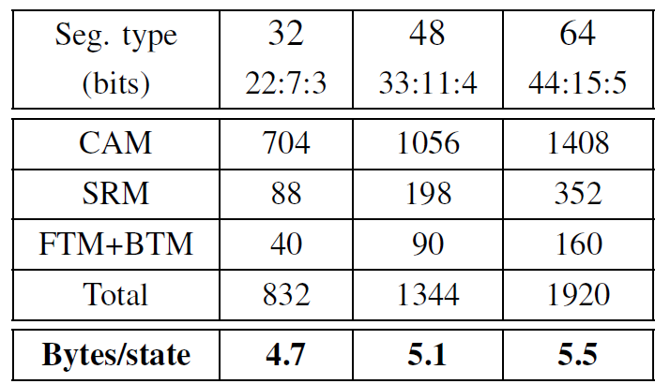
PERFORMANCE EVALUATION

Slide 38
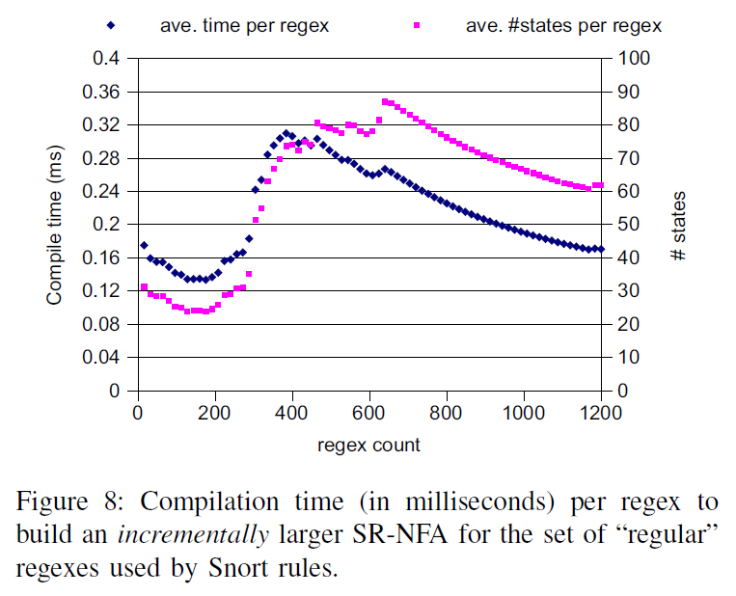

Slide 39
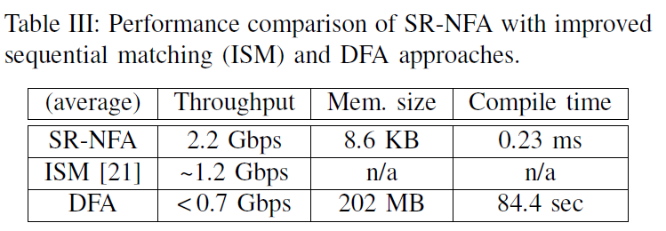

Slide 40
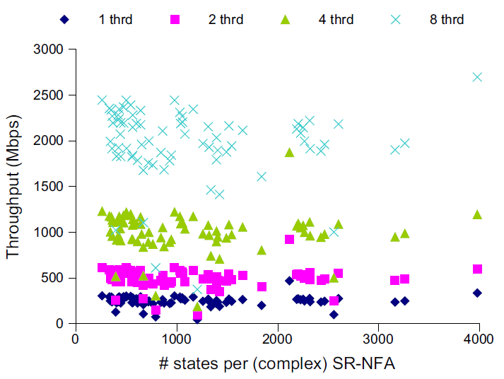
Throughput scaling

